Slide 1
Thermal Image Quality Assessment and Validation for Breast Cancer Classifier Inference
Thesis Presentation
Andreas Tamanis
Supervisor: Prof. Christodoulou Christos
University of Cyprus – Computer Science Department
December 2025

Slide 2

Motivation
Thermal imaging is a promising, non-invasive technique for breast cancer screening.
When combined with artificial intelligence, it can help detect subtle temperature patterns related to abnormal tissue activity.
However, AI models are highly sensitive to input image quality, and unreliable images can lead to unstable or incorrect predictions.

Slide 3
Problem Statement
AI-based breast cancer classifiers assume that input thermal images are correctly captured and of sufficient quality.
In real-world screening scenarios, images may be blurred, poorly posed, occluded, or affected by background thermal artefacts.
Currently, there is no automated mechanism to detect and reject such invalid images before inference.

Slide 4
MammoCheck
MammoCheck is a startup company developing an AI-based thermal breast cancer screening platform that will allow users to conduct breast cancer self-tests.
Images are captured outside controlled laboratory environments, often by non-expert users at their homes.
Without automated quality validation, unreliable images may reach the classifier and compromise system reliability.

Slide 5
Objectives
The goal of this thesis is to design an automated pipeline that evaluates whether a thermal breast image is suitable for classification.
The pipeline verifies image sharpness, patient pose, background cleanliness, anatomical geometry, and breast band thermal quality.
Only images that satisfy all quality constraints are forwarded for AI-based inference.

Slide 6
Research Gaps
Most existing work in thermal breast imaging focuses on classification and segmentation.
Image quality is typically assumed rather than explicitly validated.
There is limited research on automated, pre-inference quality assessment for thermal breast images.

Slide 7
Thesis Contributions
This work introduces a multi-stage quality assessment pipeline tailored to thermal breast imaging.
The pipeline combines rule-based image processing with lightweight deep learning models.
It provides explainable decisions, angle-specific validation, and novel breast band quality metrics.

Slide 8
DMR-IR Dataset Overview
141 patients
5 screening angles per patient
Captured in a controlled environment with special equipment
Patients had to follow protocols to highlight thermal details in the chest
Its main goal was to enhance thermal image breast cancer diagnosis research.

Slide 9
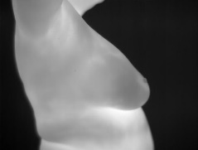
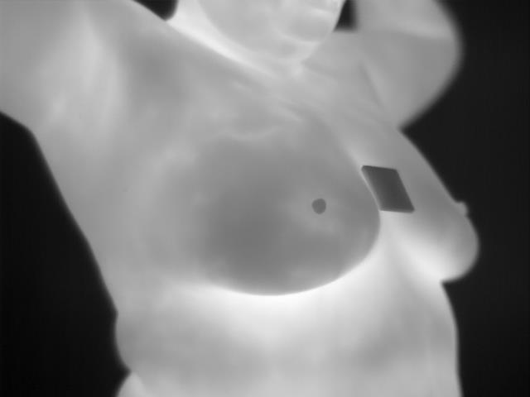
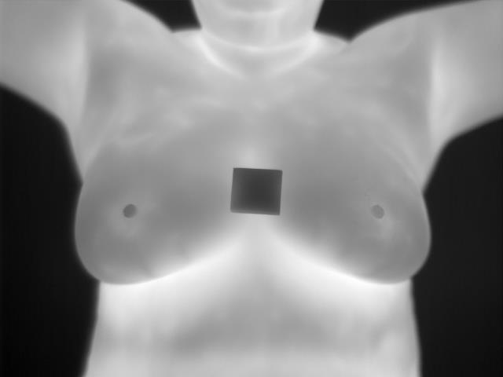
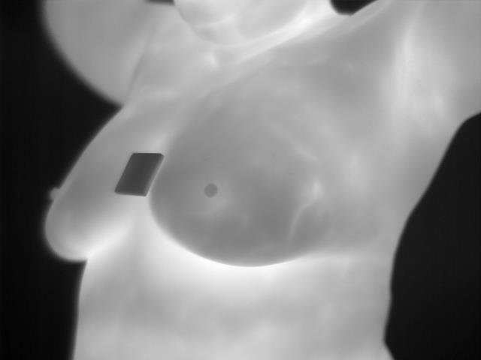
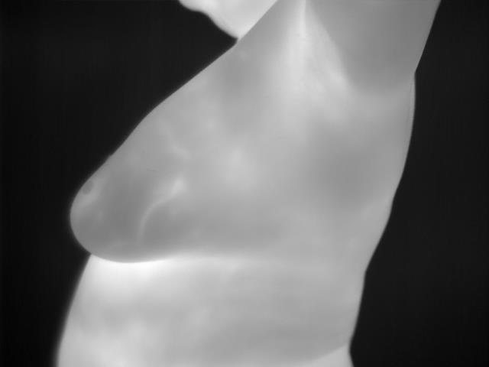
DMR-IR Dataset
Patient screening angles:
Frontal – 0 degrees
Right Lateral 45 degrees
Left Lateral 45 degrees
Right Lateral 90 degrees
Left Lateral 90 degrees
Image structure:
640x480 pixels
Grayscale
Focused on the breasts

Slide 10
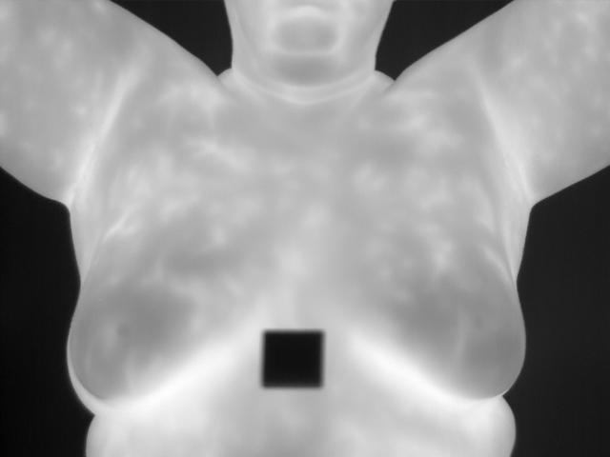
DMR-IR Dataset Protocols
Patient protocols:
Arms raised above the head
No clothing or accessories
Hair clamped and not visible
20 minutes of body cooling
No liquids or lotions applied to the body during cool down period

Slide 11
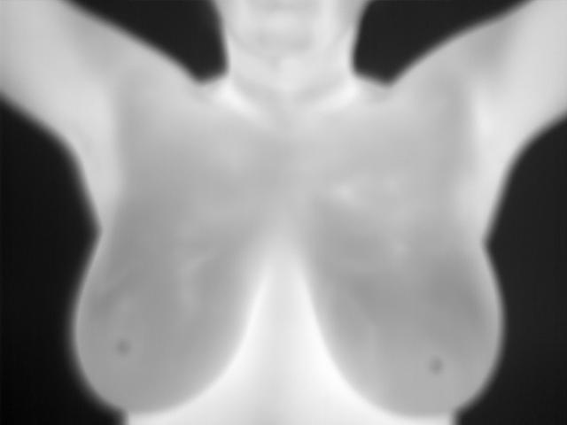
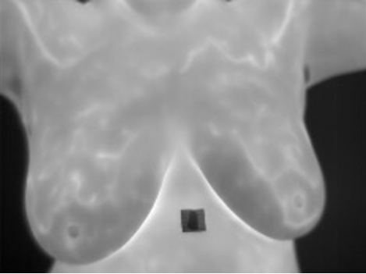
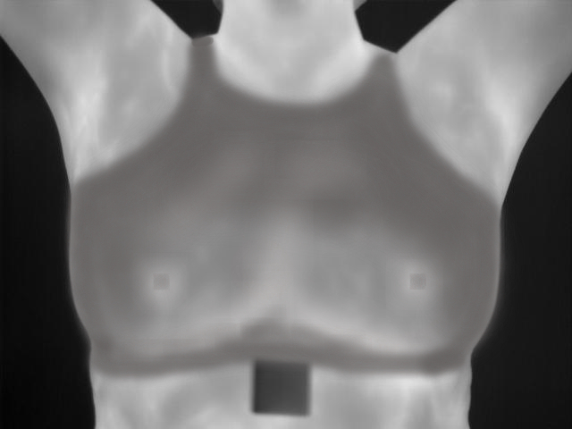
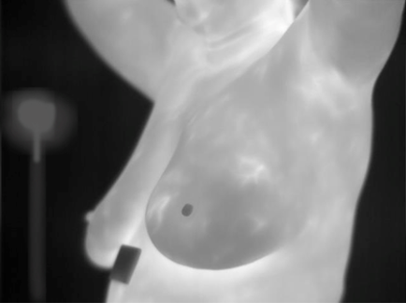
Incorrect Captures - Errors
Blurry images
Thermal noise or objects in the background
Incorrect arm placement
Clothing/Accessories
Misalignment of chest region
Uniform thermal detail on the breasts
Occlusions

Slide 12


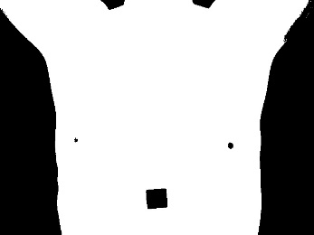


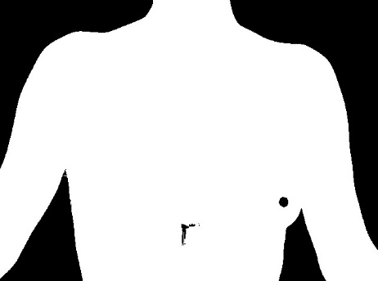












Preprocessing Binary Valid/Invalid Pose dataset
Used to train CNN models to classify valid and invalid poses

Slide 13
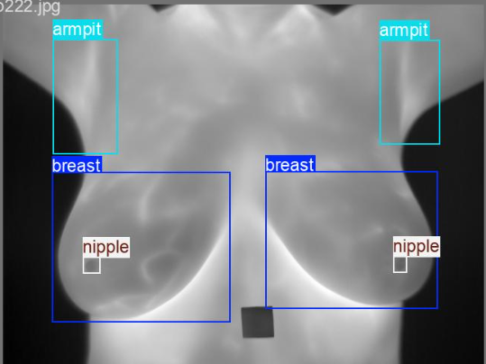
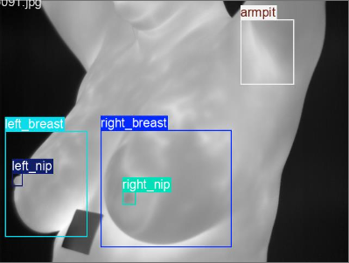
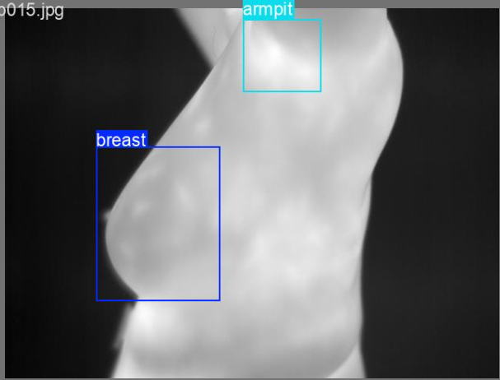
Preprocessing Anatomical landmark labeled dataset

Slide 14

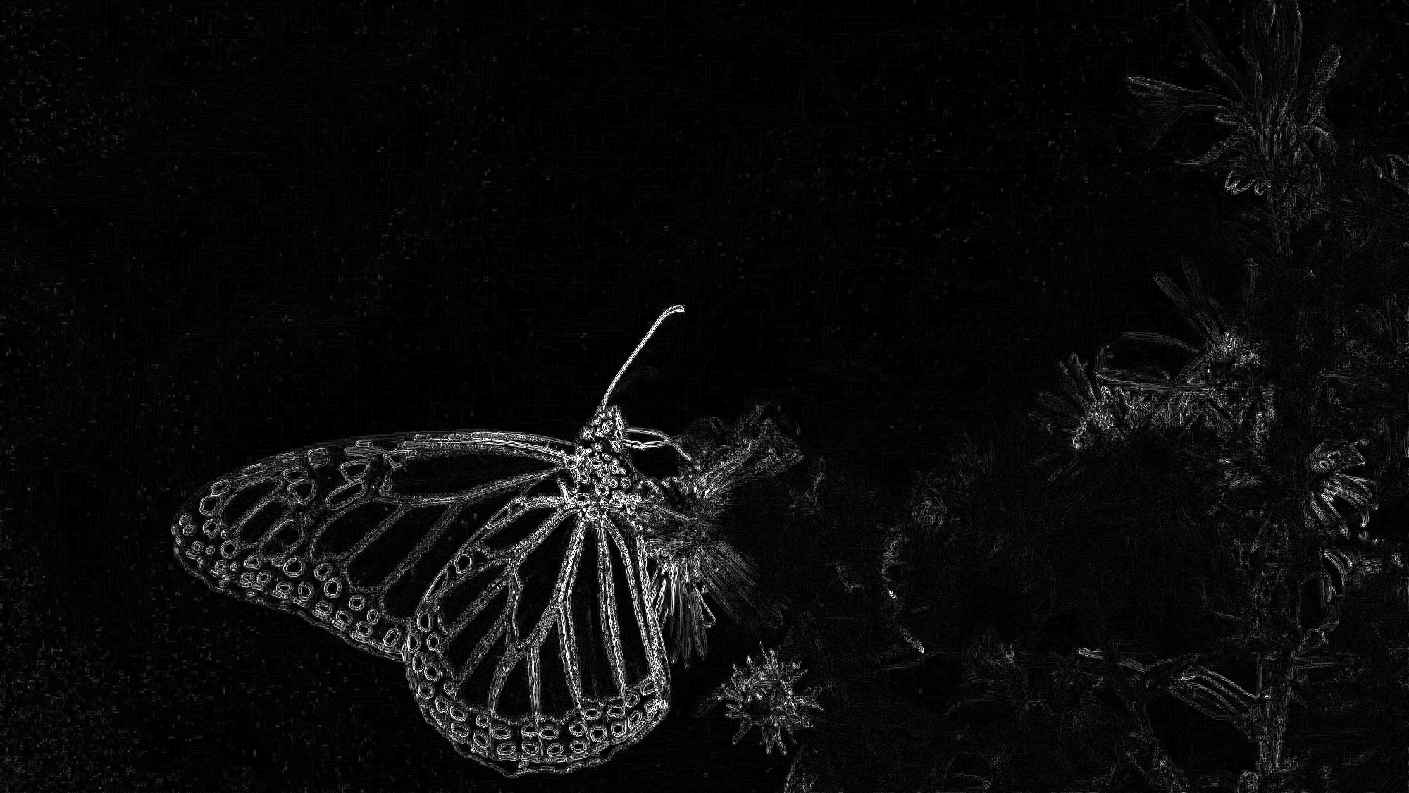
Methodology Technical background
The Laplacian Filter

Slide 15
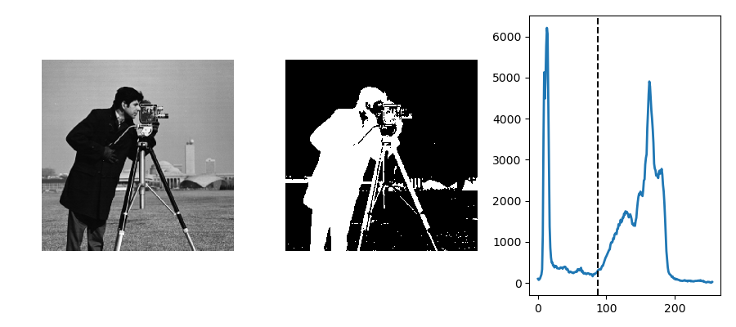
Methodology Technical background
Binary image conversion - Otsu’s threshold

Slide 16
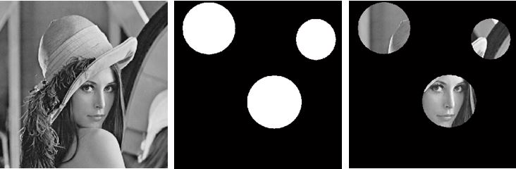
Methodology Technical background
Binary Masks

Slide 17
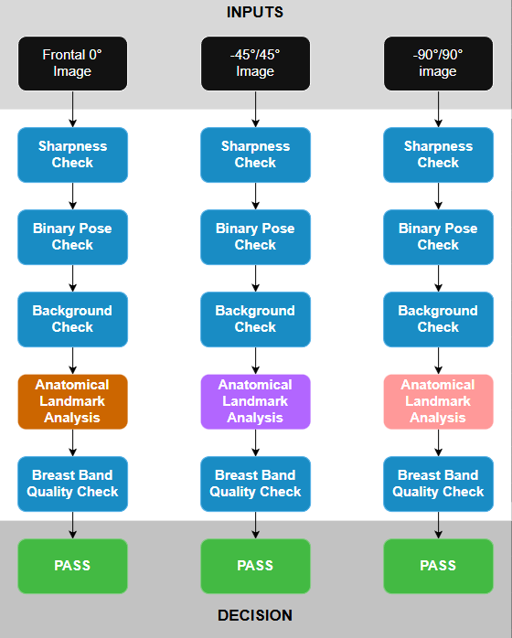
Methodology Pipeline overview
1 sequential pipeline for each screening angle
Image is discarded is it fails a check
Checks in blue are shared for each pipeline with different thresholds
Anatomical Landmark check algorithms are unique to each screening angle
Symmetrical angles are checked through the same pipeline

Slide 18
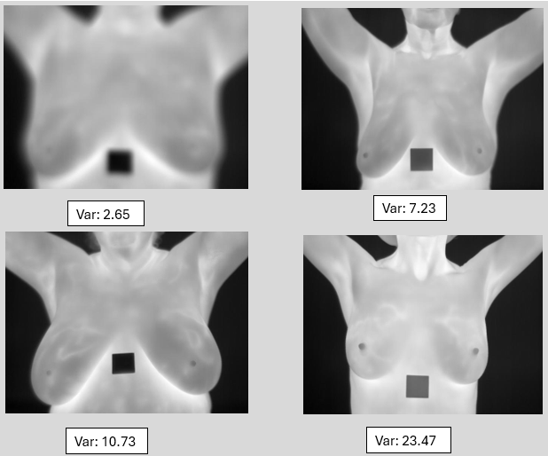
Methodology Sharpness Check
Applies the Laplacian filter on the image to get rate of intensity changes
Calculates the variance of the Laplacian response
A high variance value indicates sharpness

Slide 19
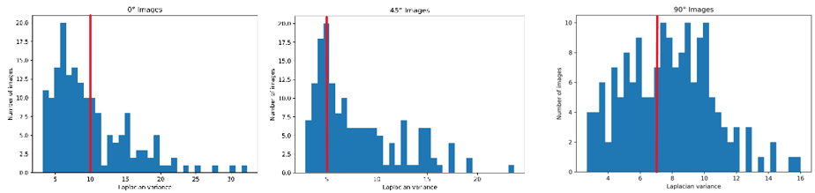
Methodology Sharpness Check
Thresholds:
Frontal: 10.0
45 degrees: 5.0
90 degrees: 7.0

Slide 20
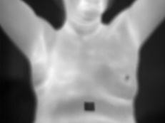


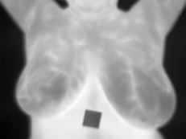
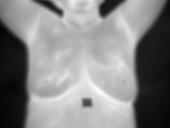
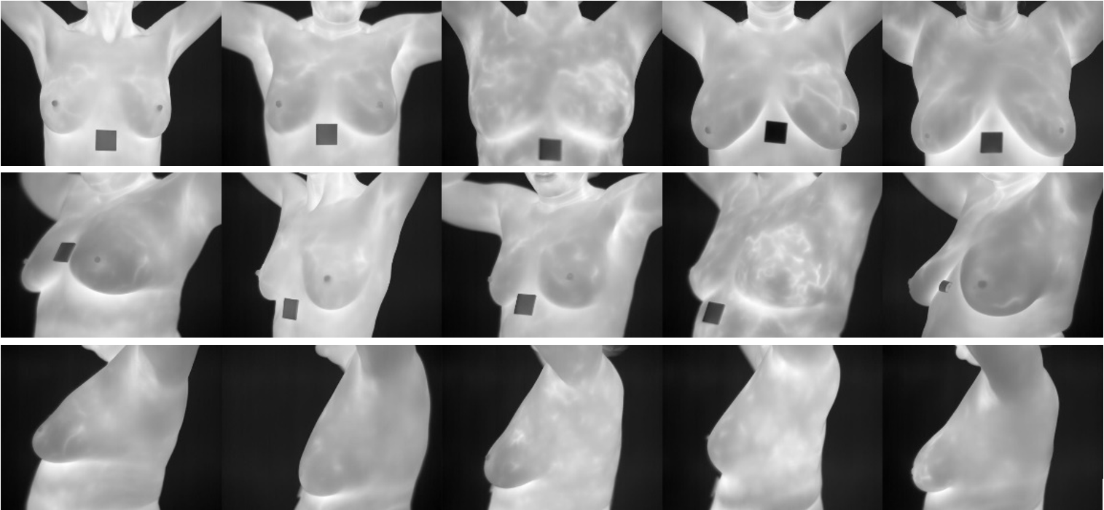
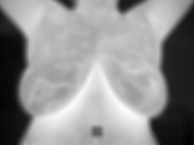
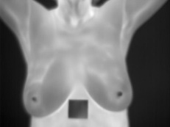
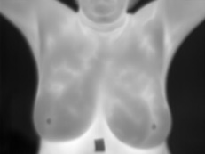
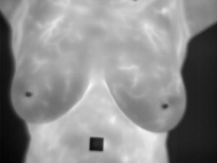
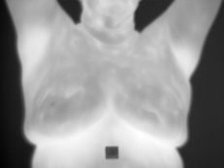
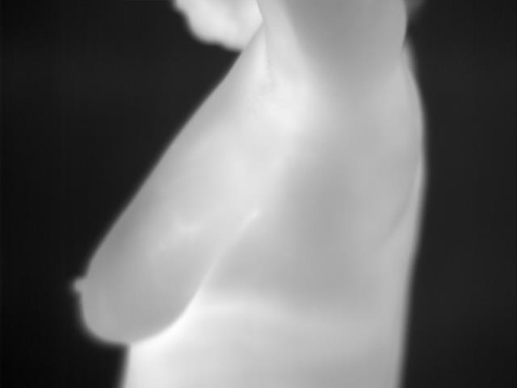
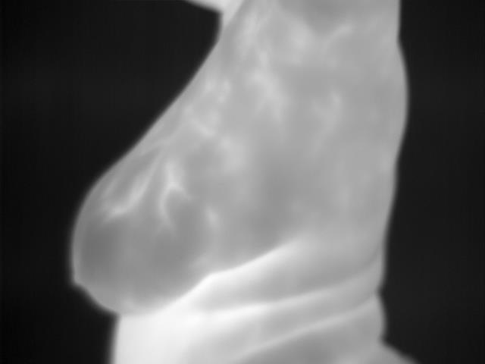
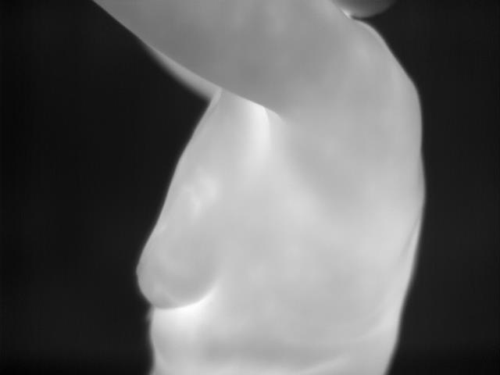
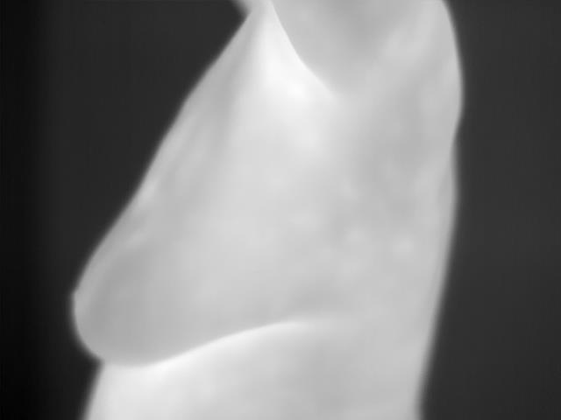
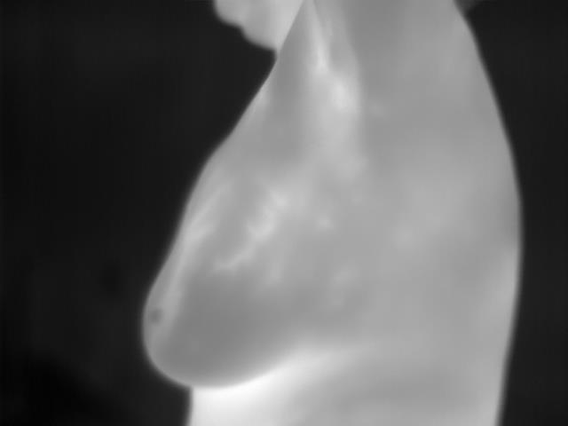
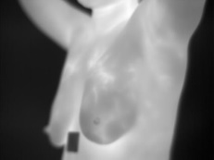
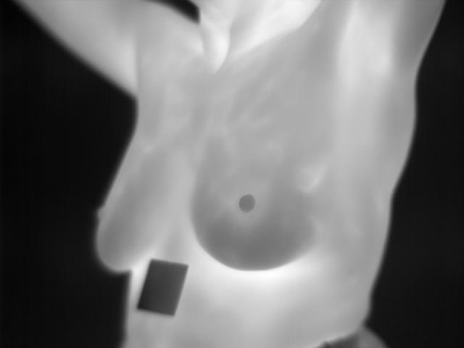
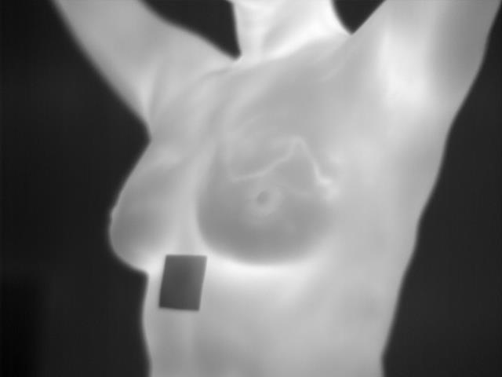
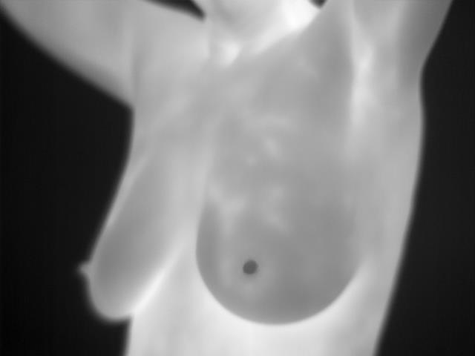
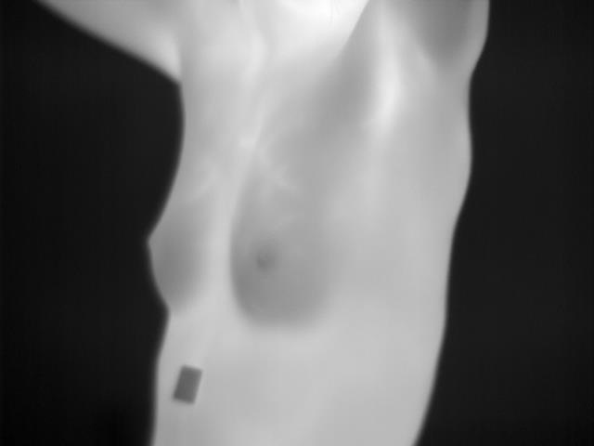
Methodology Sharpness Check

Slide 21
Methodology Binary Pose Check
The check determines if the patient being captured is holding an appropriate pose, with their arms raised.
This is achieved by creating a binary image of the patient representing their silhouette, and evaluating it using a ML model.
For each angle, a YOLOv8cls classifier model was trained with the binary pose dataset containing valid and invalid poses.

Slide 22
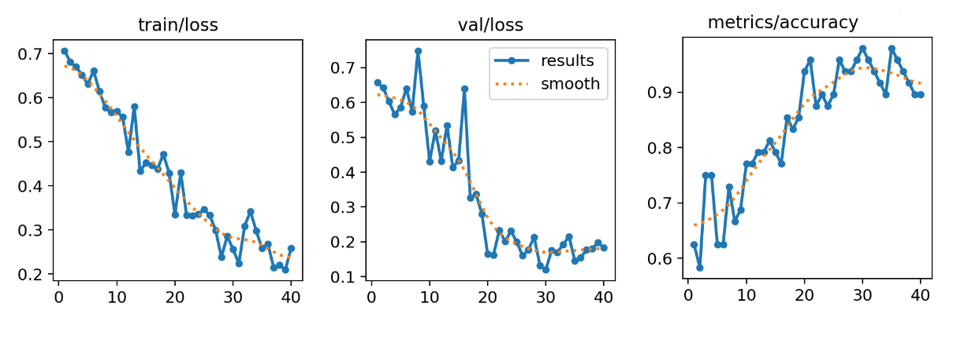
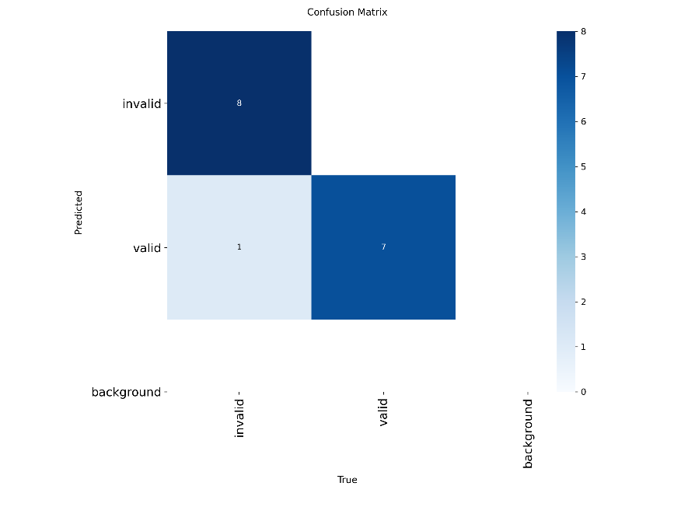
Methodology Binary Pose Check
Frontal model training and results:
The model was trained for 40 epochs
149 images in the dataset
Dataset split:
80% training
10% validation
10% testing

Slide 23
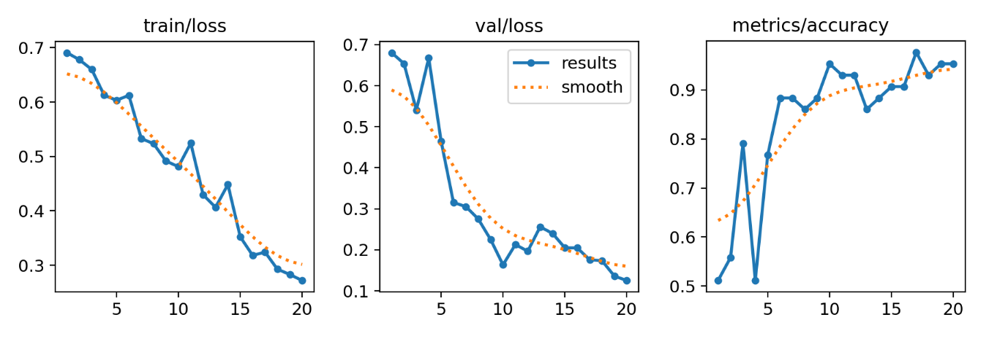
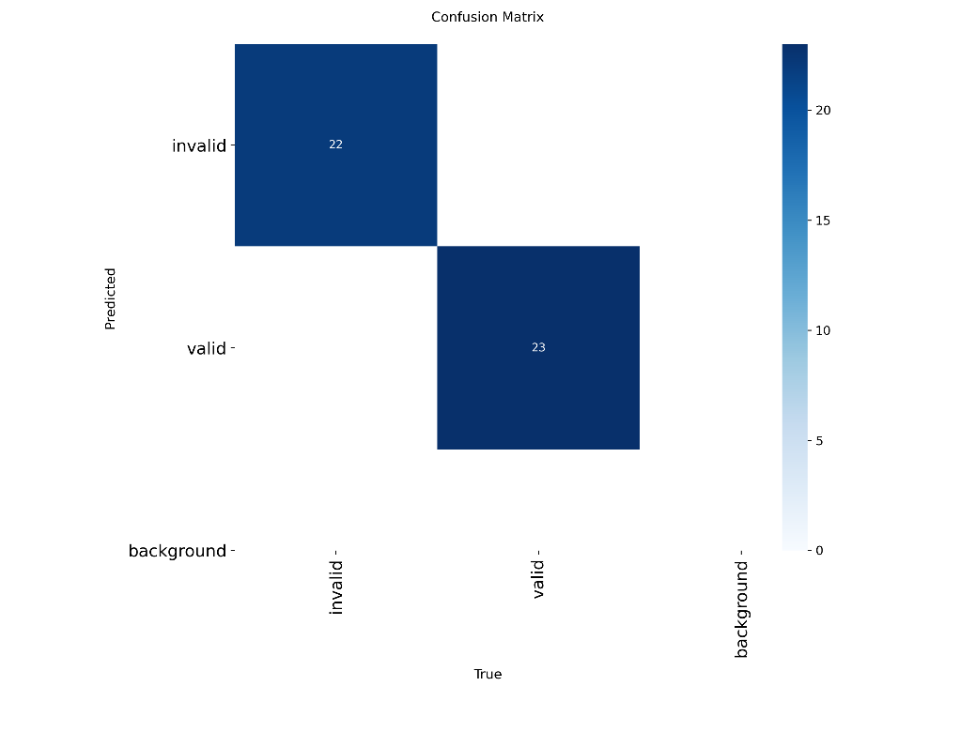
Methodology Binary Pose Check
Frontal model training and results:
The model was trained for 20 epochs
289 images in the dataset
Dataset split:
70% training
15% validation
15% testing

Slide 24
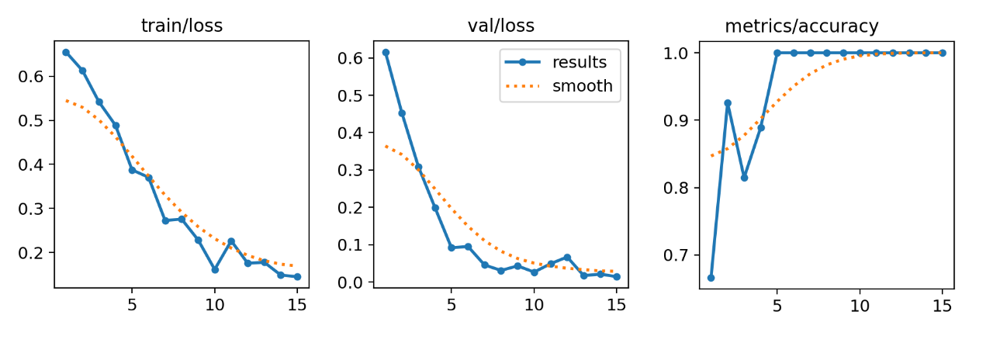
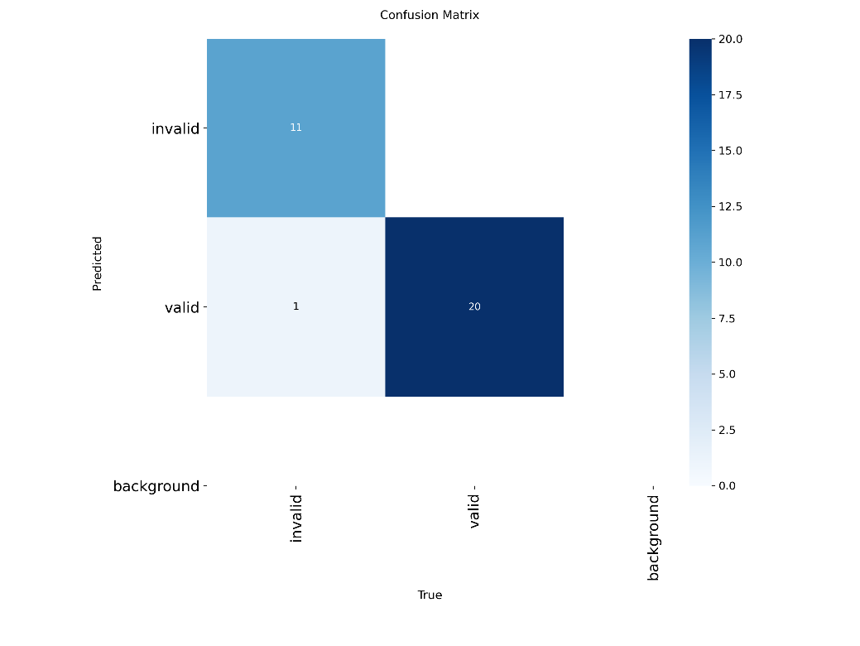
Methodology Binary Pose Check
Frontal model training and results:
The model was trained for 15 epochs
195 images in the dataset
Dataset split:
70% training
15% validation
15% testing

Slide 25
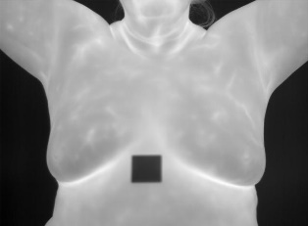




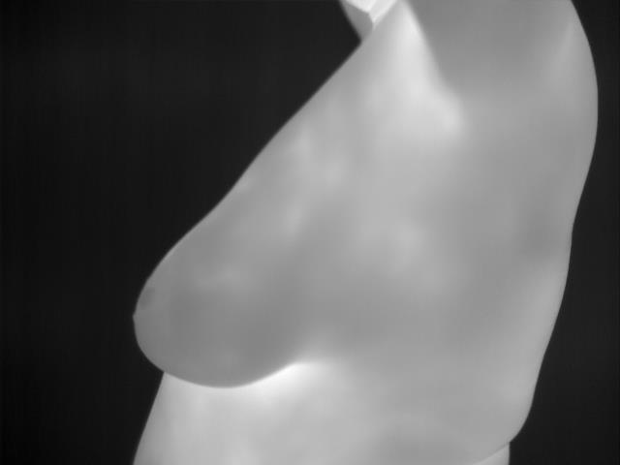


Methodology Binary Pose Check
Image preprocessing for classification
The grayscale thermal image is converted to binary using Otsu’s threshold
It is then padded to a square image in order to be compatible for YOLOv8cls inference
The padded binary image is inferred to the classifier and is classified as valid or invalid

Slide 26
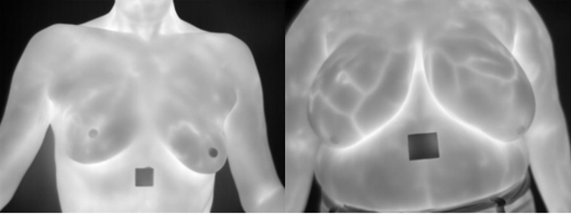
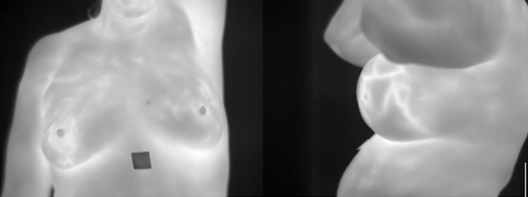
Methodology Binary Pose Check
Examples of the only original thermal images containing patients holding incorrect poses
The models can correctly classify them as invalid

Slide 27
Methodology Background Check
The background check determines if the background in the image is free from thermal activity and noise.
It achieves this by segmenting the background, calculating statistical metrics and applying filters.

Slide 28

Methodology Background Check
Background segmentation:
The thermal image is converted to a binary mask using Otsu’s threshold
More than 1 white element in the mask indicates a thermal object in the background, and the image fails
The background mask is filled and flipped to highlight the background, and is eroded to create a margin between the body edge and the background region

Slide 29
Methodology Background Check
Laplacian variance on the background:
The Laplacian variance is calculated on the background pixels using the mask
A high Laplacian variance value indicates the existence of edges in the background, or thermal mist-like noise
Intensity mean on the background:
The background pixels are then segmented into 8x8 blocks, and the intensity mean of each block is calculated
A high intensity mean in an 8x8 block indicates faint thermal activity, not sharp enough to create edges

Slide 30



Methodology Background Check
Examples of images classified with noisy backgrounds:
Examples of images classified with acceptable backgrounds:

Slide 31
Methodology Anatomical Landmark Detection
The Anatomical Landmark Detection component aims to detect important objects like breasts, armpits and nipples, and compose a general geometry of those detections to determine proper alignment.
This component follows a different methodology for the 3 different angles, but the general idea remains the same

Slide 32



Methodology Anatomical Landmark Detection
The component uses a YOLOv8s detector trained on the labeled dataset, to detect the position of important anatomical landmarks like breasts, armpits and nipples.
Using these detections the algorithm computes metrics based on the location of these detections
These metrics can then be used to assess misalignments

Slide 33


Methodology Anatomical Landmark Detection
Frontal detector model training and results:
20 epochs
168 labeled images
Dataset split:
80% training
10% validation
10% testing

Slide 34


Methodology Anatomical Landmark Detection
45 degree detector model training and results:
30 epochs
153 labeled images
Dataset split:
80% training
10% validation
10% testing

Slide 35


Methodology Anatomical Landmark Detection
90 degree detector model training and results:
25 epochs
148 labeled images
Dataset split:
80% training
10% validation
10% testing

Slide 36




Methodology Anatomical Landmark Detection
The frontal check ensures that both breasts and both armpits are present in the image
Nipples are not guarantied in breast thermal images, so if they are absent, virtual nipples are generated based on the position and size of the breasts
After all detections are made and evaluated, their positions are used to calculate metrics

Slide 37


Methodology Anatomical Landmark Detection
The metrics calculated:
Breast distance to image width ratio
Armpit distance to image width ratio
Armpits distance to Breasts distance ratio
Nipple midline point offset (x-axis)
Armpit midline point offset (x-axis)
Nipple to armpit midpoint offset (x-axis)
Nipple angle
Armpit angle
Nipples and armpits angle difference

Slide 38

Methodology Anatomical Landmark Detection
The 45-degree check ensures that both breasts and the only visible armpit are present in the image.
Again, nipples are not guarantied in breast thermal images, so if they are absent, virtual nipples are generated based on the position and size of the breasts
After all detections are made and evaluated, their positions are used to calculate metrics

Slide 39




Methodology Anatomical Landmark Detection
The metrics calculated:
Nipple angle
Nipple distance to image width ratio (x-axis)

Slide 40




Methodology Anatomical Landmark Detection
The 90-degree check ensures that the breast and armpit lie in expected regions in the image.
Nipples are not detected, as they are of no use
The position limitations are the only rules enforced by this version of the check, since no meaningful geometry can be formed using the detections.

Slide 41




Methodology Anatomical Landmark Detection
More examples:

Slide 42


Methodology Anatomical Landmark Detection
More examples:

Slide 43
Methodology Breast Band Quality check
The Breast Band Quality check aims to assess the thermal detail and patterns of the patients using statistical metrics on their intensities
This check follows the same methodology for all 3 angles

Slide 44


Methodology Breast Band Quality check
This check aims to detect patients with too high body temperature, faint thermal details formed by blood vessels, and occlusions caused by clothing or liquids applied to the body during cooling.
This is achieved by isolating the body with a binary mask and computing statistical metrics like mean and variance on the intensities.

Slide 45











Methodology Breast Band Quality check
The body is isolated by creating a binary mask from the original image.
This mask is then eroded to create an edge between the edge of the body and the inner chest region, and then cropped from the top and the bottom to discard the neck and the stomach from the mask.

Slide 46


Methodology Breast Band Quality check
Occlusions are regions of the chest that show a large temperature drop relative to the rest of the body.
Cold pixel intensity: μ – κ*σ
κ=0.9
Pixels with intensity below μ-κ*σ are highlighted in a binary mask and clustered into elements
If an element covers more than a percentage of the breast area, it is considered an occlusion

Slide 47


Methodology Breast Band Quality check
By calculating the mean of all the breast pixel intensities, the body temperature of the patient can be estimated.
A higher intensity mean signals improper cooling, while a lower intensity mean can indicate clothing occlusions.
By calculating the variance of these intensities, the blood vessel thermal details can be assessed.
Good thermal details are large and sharp intensity changes throughout the chest.

Slide 48


Methodology Breast Band Quality check
Valid Examples:

Slide 49


Methodology Breast Band Quality check
Invalid Examples:

Slide 50
Limitations
Thermal image dataset captured in controlled environments with minimal invalids
Empirical thresholds
No direct accuracy evaluation due to manually generated data

Slide 51
Future Work
Future Work:
Evaluate on real world datasets
Training ML models for adaptive thresholding of the metrics
Testing the impact of this pipeline to downstream breast cancer classifiers

Slide 52
Thank You

